Slide 1
Threat & Risk Concepts
Concepts as a foundation for the threat & risk conceptual model

Slide 2
High-level “flow” of “bad stuff”
Threat
Actor
Threat
Risk
Consequence
Impact on Objectives
Stakeholder

Slide 3
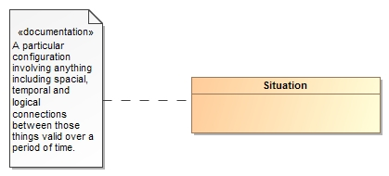
Threats and Risks of What?
A threat or risk is with respect to some undesirable situation
What is a situation?
We define a situation as a configuration of things…
People places, things, events, occurrences and the connections between them.
Some situations are consequences of others
Situations provide a link between different kinds and phases of threats & risks

Slide 4
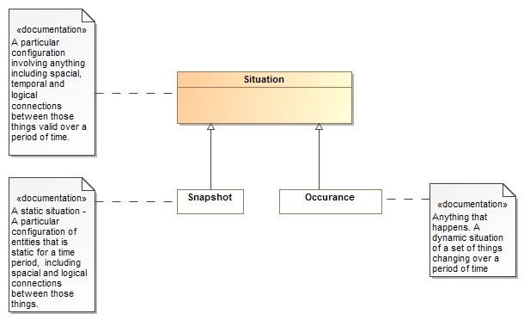
Situations can be a snapshot in time or an event occurring over time

Slide 5

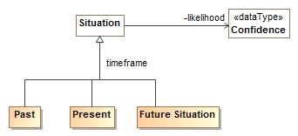
Situations Over Time
Situations can exist in the
Past (History)
Present (Current event)
Future (Expectation)
Situations have a likelihood
Past
Present
Future
Noting is for sure – so any situation can have a likelihood

Slide 6


Consequences
The same situation or kind of situation may be desired by some and unwanted by others based on the consequences
Consequences are relative to the objectives of one or more stakeholders
The impact of a consequence can be computed from the likelihood, degree of affect and importance
The desirability of any situation is the net of all the potential consequences.
Benefit
Don’t Care
Detriment

Slide 7
Classifying Situations across time and Consequence
Past
Present
Future
RISK
Benefit
Don’t Care
Detriment

Slide 8
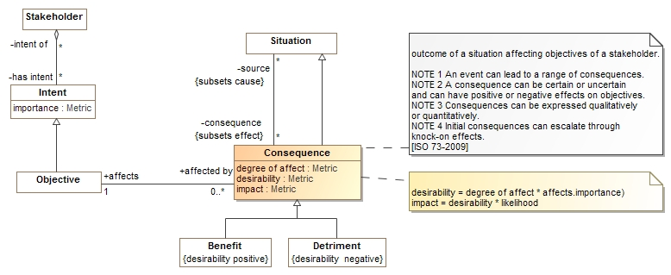
Consequence Model
Situations have consequences (an effect of the situation)
Consequence can be positive or negative: benefits or detriments, respectively
Consequences affect the objectives of stakeholders
This leads to the desirability of the consequence (positive or negative)
Desirability * likelihood provide the impact (→risk metric for detriments)

Slide 9
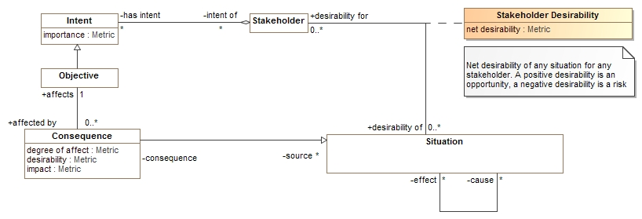
Desirability
The desirability of any situation for any stakeholder can then be computed based on the desirability of all consequences
“Risk” as a metric is a negative net desirability of a future situation

Slide 10
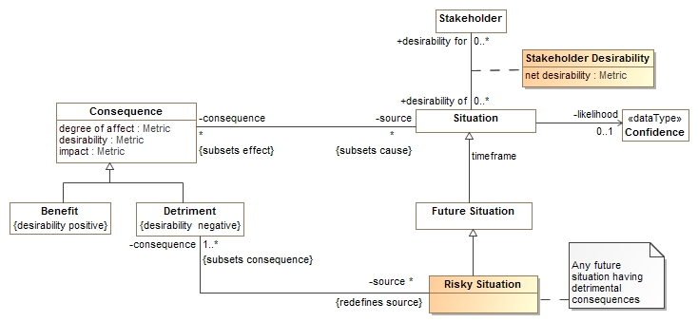
Risk
A risky situation is a future situation that has consequences that are a detriment to the objectives of some stakeholder
A risky situation (like all situations) have a net desirability for a stakeholder.
Risky situations correspond to the view of risks as situations or events
Net desirability (negative) corresponds to the view of risk as a metric

Slide 11
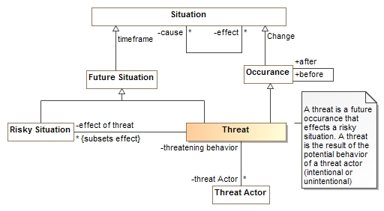
Threat
A threat is an occurrence that leads to a risky situation that is a potential behavior of a threat actor
A threat is not necessarily intentional

Slide 12
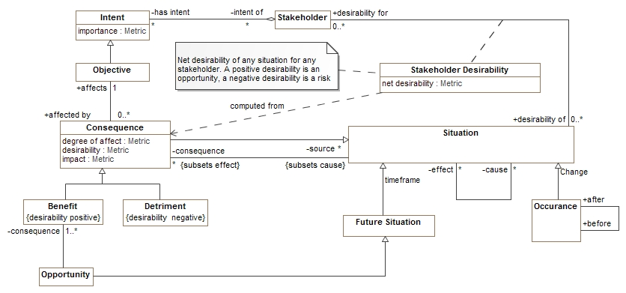
Opportunities
The opposite of a risky situation, opportunities have positive consequences – benefits.

Slide 13
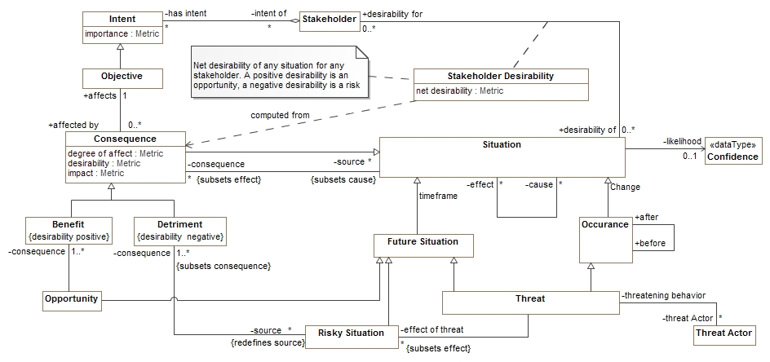
Putting threat and risk together
Note that a situation may be classified by multiple types

Slide 14
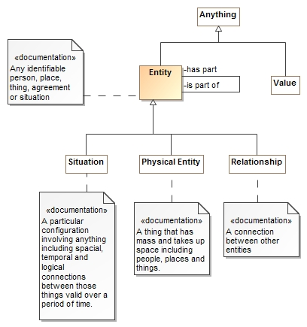
Entities
An entity is something you can identify, or name.
A situation is one kind of “Entity”.
Physical things are also entities
As are contracts, agreements and other relationships
Entities may have “parts” or be part of other things
Things that are not entities are values, like numbers.

Slide 15
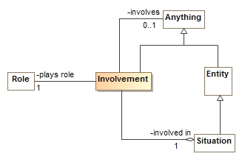
Involvement
Situations involve other things playing roles
The “involvement” relates a situation, the role played and the entity or value involved
Roles are types (categorizations) of things involved in situations
E.g. victim, perpetrator, weapon
Sometimes the actual thing playing the role is unknown, so the involved element is optional

Slide 16
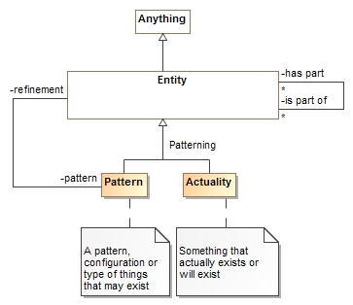
Patterns
Entities (including situations) may be actual things or events or patterns of them.
An “Actuality” is a real thing or something or a specific happening
A pattern can have a refinement (more specific configuration) that is another pattern or actuality
Everything true of a pattern must be true of its refinements.
Involved entities
Parts
Property Values
Rules
Situations can be used as patterns or actualities

Slide 17
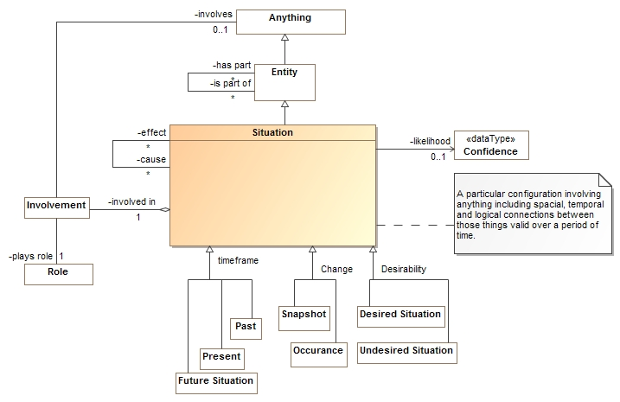
Summarizing Situations

